Slide 1
COP4020 Programming Language Concepts
Parsing 1
© Beverly A Sanders, 2023

Slide 2
Where we are
Recall: first step of language translation is lexical analysis (or scanning)
Converts sequence of characters into a sequence of tokens
Lexical structure usually specified with regular expressions
Second step of language translation is parsing
Recognizes legal phrases (order of tokens)
Constructs AST (Abstract Syntax Tree)

Slide 3
New formalism
Regular expressions are not recursive, thus cannot specify nested constructs
Example: language of expressions
(x + y) + (w + z)
is an expression with
two subexpressions, (x + y) and (w + z)
each with two subexpressions x and y, and w and z
parentheses must match
The language of expressions cannot be specified with regular expressions.

Slide 4
Backus-Naur formalism
Instead, we specify the language with a grammar using BNF (Backus-Naur Form) or EBNF (extended BNF) notation.
In particular, we are interested in context-free-grammars (CFG)

Slide 5
Context Free Grammar
A grammar is a tuple (Σ, N, P, S) where
Σ is a set specifying the alphabet of tokens (also called terminal symbols).
N is the set of non-terminal symbols.
non-terminals are variables that denote sets of sentences.
impose a hierarchical structure on sentences.
P is a set of productions (substitution rules).
S is the start symbol where S is in N.

Slide 6
Benefits of (E)BNF notation
Compact and precise specification that allows an infinite number of sentences to be specified with a finite definition
Allows systematic or automatic generation of efficient parsers for certain types of grammars
Provides a framework for specifying semantics.
Allows formal reasoning about languages.

Slide 7
Example
S ::= ε
S ::= (S)S
Σ, N are left implicit
but Σ = {(,)}, N = {S}
Recursive: S is defined in terms of itself
ε is the empty sequence
What language does this grammar generate?

Slide 8
Example
Set of strings of balanced parentheses
S ::= ε
S ::= (S)S
Σ, N are left implicit
but Σ = {(,)}, N = {S}
Recursive: S is defined in terms of itself
ε is the empty sequence
What language does this grammar generate?

Slide 9
EBNF Notation
Pure BNF only allows productions of the form σ1 ::= σ2, where σ1 and σ2 are strings of terminal and non-terminal symbols.
EBNF (extended BNF) adds |, *, + from RE
Example
BNF
A ::= α B γ
B ::= β B
B ::= ε
EBNF
A ::= α β* γ
These grammars generate
the same language
Notes:
BNF leads to recursion in parser, EBNF iteration in parser

Slide 10
Example
expr ::= factor | expr op factor
factor ::= ident | numlit | ( expr )
ident, numlit, op are tokens which were defined in previous lectures.
<token> ::= <identifier> | <numlit> | <op> |
<numlit> ::= <nonzero digit> <digit>* | 0
<digit> ::= 0 | <nonzero digit>
<nonzero digit> ::= 1 | 2 | 3 | 4 | 5 | 6 | 7 | 8 | 9
<identifier> ::=
<identifier start> <identifier part>*
<identifier start> ::= A .. Z | a..z | $ | _
<identifier part> ::=
<identifier start> | <digit>
<op> ::= + | == | *

Slide 11
Examples
expr ::= factor | expr op factor
factor ::= ident | numlit | ( expr )
Some expressions:
x
34
s + 2
s==3+4
(4+5)==9
(1 * (2+3) == 4) + 5
abc == 34 * 4

Slide 12
What is Σ?
expr ::= factor | expr op factor
factor ::= ident | numlit | ( expr )

Slide 13
What is Σ ?
expr ::= factor | expr op factor
factor ::= ident | numlit | ( expr )
= {ident, numlit, op, ( , ) }
For parsing, we only care about the token kind (ident or numlit) not their values.

Slide 14
Derivation of expressions
expr ::= factor | expr op factor
factor ::= ident | numlit | ( expr )
x
Notes:
expr →
factor →
ident(x)

Slide 15
Derivation of expressions
expr ::= factor | expr op factor
factor ::= ident | numlit | ( expr )
x
expr →
factor →
ident(x)
Notes:
-> means a derivation step

Slide 16
Derivation of expression (2)
expr ::= factor | expr op factor
factor ::= ident | numlit | ( expr )
34
Notes:
expr →
factor →
numlit(34)

Slide 17
Derivation of expression (2)
expr ::= factor | expr op factor
factor ::= ident | numlit | ( expr )
34
expr →
factor →
numlit(34)

Slide 18
Derivation of expression (3)
expr ::= factor | expr op factor
factor ::= ident | numlit | ( expr )
s+2
Notes:
expr →
expr op(+) factor →
factor op(+) factor →
ident(s) op(+) factor →
ident(s) op(+) numlit(2)

Slide 19
Derivation of expression (3)
expr ::= factor | expr op factor
factor ::= ident | numlit | ( expr )
s+2
expr →
expr op(+) factor →
factor op(+) factor →
ident(s) op(+) factor →
ident(s) op(+) numlit(2)

Slide 20
Exercises
s==3+4
(4+5)==9
(1 * (2+3) == 4) + 5
abc == 34 * 4

Slide 21
We are interested in context-free grammars
A grammar with a rule like
aSb ::= ….
is NOT context-free. It says that S can be replaced by right hand side only when it appears between a and b.
A CFG has only single nonterminal on left hand side of all rules.
Programming languages are NOT context free.
But we use context-free grammars anyway
A context-free description of the grammar is a useful starting point for implementation of translators.
The context constraints are specified and checked using different techniques.

Slide 22
Parsing
Grammars give rules for generating sentences in a language
Parsing is the process of recognizing the language (and determining its structure)
Parse trees are a way of representing the structure of a sentence
start symbol at the root
non-terminals at interior nodes
terminals as leaves

Slide 23
Example: parse tree
Sentence ( )( ) from grammar S ::= (S)S | ε.
S
(
S
)
S
s
ε
(
S
)
S
ε
ε

Slide 24
Example: parse tree
expr ::= factor | expr op factor
factor ::= ident | numlit | ( expr )
x
expr →
factor →
ident(x)
expr
factor
ident(x)
Notes:
Note how the parse tree corresponds to the derivation

Slide 25
Example: parse tree
expr ::= factor | expr op factor
factor ::= ident | numlit | ( expr )
34
expr →
factor →
numlit(34)
expr
factor
numlit(34)

Slide 26
Example: Parse tree
expr ::= factor | expr op factor
factor ::= ident | numlit | ( expr )
s+2
expr →
expr op(+) factor →
factor op(+) factor →
ident(s) op(+) factor →
ident(s) op(+) numlit(2)
expr
expr
op (+)
factor
numlit(2)
factor
ident(s)
Notes:
Note how carried along contents of op, numlit, ident, but not needed for parsing.

Slide 27
Ambiguous Grammar
An ambiguous grammar admits more than one parse tree for a sentence.
Example
stmt ::= if_stmt | (other non-if statements).....
if_stmt ::= if boolean_expr then stmt
if_stmt ::= if boolean_expr then stmt else stmt
if b1 then if b2 then s1 else s2
if_stmt
if-stmt
if b1 then stmt
if b1 then stmt else smt
if b2 then stmt else stmt
if b2 then s1
s2
s1
s2
Notes:
Note that these parse trees leave out some detail regarding the boolean expressions.
left tree corresponds to if b1 then (if b2 then s1 else s2)
right tree corresponds to if b1 then (if then s1) else s2

Slide 28
Dealing with ambiguous grammars
Without changing the programming language being specified:
Use disambiguating rule to add “hack” to parser.
e.g. else is matched with nearest previously unmatched if
OR modify the grammar so it is non-ambiguous
Resulting grammar must generate the same language
Grammars are not unique: many grammars may specify the same languages
Change the language (if you can)
Often this improves the language

Slide 29
Example: Ambiguous grammar with disambiguating rule
else is matched with nearest previously unmatched if
if b1 then if b2 then s1 else s2
if_stmt
if b1 then stmt
if b2 then stmt else stmt
s1
s2

Slide 30
Example: modify the grammar
Distinguish between matched and unmatched statements
You can’t have an unmatched statement immediately before an else
stmt ::= matched | unmatched
matched ::=
if boolean_expr then matched else matched
| ....(other non-if stmts)
unmatched ::=
if boolean_expr then stmt
| if boolean_expr then matched else unmatched

Slide 31
stmt ::= matched | unmatched
matched ::= if boolean_expr then matched else matched
| ....(other non-if stmt)
unmatched ::= if boolean_expr then stmt
| if boolean_expr then matched else unmatched
if b1 then if b2 then s1 else s2
(only one works)
unmatched
if b1 then stmt
matched
if b2 then matched else matched
s1
s2
Notes:
unmatched -> if bexp then stmt
if bexp then matched
if bexp then if b2 then matched else matched
if bext then if bw then s1 s2
Try alternative
matched -> if bexp then matched else matched
if b2 then s2 s2 but it is not the case that matched → if b2 then s2, so this doesn’t work.

Slide 32
Example: modify the language
Change the language to explicitly terminate if statements.
stmt ::= if boolean_expr then stmt endif
| if boolean_expr then stmt else stmt endif
| other non-if statements
Allowed sentences
if b1 then if b2 then s1 else s2 endif endif
if b1 then if b2 then s1 endif else s2 endif

Slide 33
Recap
Context-free grammars
BNF, EBNF notation
Not unique—many different grammars can specify the same language
Parse trees represent structure of sentences
Ambiguous grammars admit multiple parse trees—not desirable
Solutions:
change language
change grammar
disambiguating rule

Slide 34
COP4020 Programming Language Concepts
Parsing 2
© Beverly A Sanders, 2023

Slide 35
Recap
Lexical analysis
can specify tokens with RE
recognize tokens with DFA implemented by a scanner
scanners also keep track of position of tokens in the source text and handle white space, keywords, and comments.

Slide 36
Phrase structure
use EBNF notation to specify context-free grammar
in contrast to REs, can be recursive
allows nested constructs to be specified
parsers recognize phrases
multiple CFGs can specify the same language; we try to choose one that is most appropriate for our purposes
clear to human reader
can be parsed by a desirable parsing algorithm
parse trees illustrate the structure of a phrase
an ambiguous grammar admits multiple parse trees
Options for dealing with ambiguity
Impose a disambiguating rule
Eliminate ambiguity by using a different grammar that generates the same language but is not ambiguous.
If possible, change the language.

Slide 37
Parsing Complexity
The difficulty of recognition depends on the complexity of the grammar.
Grammars can be classified according to the class of parsing algorithms that can recognize the language.
There are O(n³) algorithms that work for any context free grammar.
For useful subsets of CFG, there are linear parsers.
LL (left-to-right, leftmost derivation) top-down (hand written or generated)
LR (left-to-right, rightmost derivation) bottom-up (usually generated)
Notes:
n is the length of the input program.

Slide 38
Approaches to parsing
bottom-up
we will only briefly cover this
top-down (recursive descent)
we will focus on this and use in our project
characteristics of grammars that allow top-down parsing
LL grammars
FIRST, FOLLOW, and PREDICT sets
transformations on grammars

Slide 39
Bottom-up parsing
Scan, looking for leftmost substring that matches r.h.s of some production, replace with l.h.s.
Repeat.
If the start symbol is obtained, the sentence is in grammar.
Bottom-up parsers are usually generated by a tool.

Slide 40
Example: Bottom up parsing
S ::= AB
A ::= x | y
B := z | w
String to parse: xw
Notes:
Find a prefix of xw on the right hand side of a production
xw
->
Aw
->
AB
->
S

Slide 41
Example: Bottom up parsing
S ::= AB
A ::= x | y
B := z | w
String to parse: xw
xw
← Aw ← AB ← S This is the start symbol, so the string is in the language

Slide 42
Example 2: Bottom-up parsing (1)
S ::= aABe
A ::= Abc | b
B ::= d
String to recognize: abbcde
Notes:
abbcde
->

Slide 43
Example 2: Bottom-up parsing (2)
S ::= aABe
A ::= Abc | b
B ::= d
String to recognize: abbcde
Scan, looking for substring that matches the right side of some production.
b and d qualify.
Choose leftmost one, b, and replace it by A
abbcde
←
aAbcde

Slide 44
Example 2: Bottom-up parsing (3)
S ::= aABe
A ::= Abc | b
B ::= d
String to recognize: abbcde
abbcde
←
aAbcde
Now substrings Abc, b, and d match a r.h.s, Abc is leftmost, so replace Abc by A
aAbcde
←
aAde

Slide 45
Example 2: Bottom-up parsing (4)
S ::= aABe
A ::= Abc | b
B ::= d
String to recognize: abbcde
abbcde
←
aAbcde
←
aAde
replace d with B
aAde
←
aABe

Slide 46
Example 2: Bottom-up parsing (5)
S ::= aABe
A ::= Abc | b
B ::= d
String to recognize: abbcde
abbcde
←
aAbcde
←
aAde
←
aABe
←
S

Slide 47
Top-down parsing
Start with start symbol in language
At each step, replace a nonterminal symbol with one of its productions, trying to match prefixes in the sentence
Remove matching prefixes
If the resulting string is empty, then the sentence is in the grammar

Slide 48
Example: Top-down parsing (1)
S ::= AB
A ::= x | y
B := z | w
String to parse xw

Slide 49
Example: Top-down parsing (2)
S ::= AB
A ::= x | y
B := z | w
String to parse xw
S xw
->
AB xw
->
xB xw
->
B w
->
w w
Notes:
S xw
->
AB xw
->
xB xw
->
B w
->
w w

Slide 50
Grammars and Parsing
Recall grammars generate, parsers recognize
O(n³) parsing algorithms that work with any context-free grammar exist, but we want a linear algorithm
Goal: identify special classes of context-free grammars that can be parsed with linear algorithms
LL grammars (top down parsing alg.)
LR grammars (bottom up parsing alg.)
Now we will explore LL(1) grammars in more detail
Look at some motivating examples to see problems
State rules for grammars that rule out the problematic situations
LL(k) means that the grammar can be parsed by looking ahead at most k tokens. (This idea will be clearer later)
Notes:
For our project, we want one symbol lookahead most of the time

Slide 51
Top-down parsing
S ::= A|B
A ::= xA | y
B ::= xB | z
String to parse: xxz
What language is described by this grammar?
Notes:
Language: zero or more x followed by y, or zero or more x followed by z (string is in language)
S xxz
→ (choose A)
A xxz
→
xA xxz
→ (consume x)
A xz
→
xA xz
→ (consume x)
A z

Slide 52
Top-down parsing
S xxz
→ (choose A)
A xxz
→
xA xxz
→ (consume x)
A xz
→
xA xz
→ (consume x)
A z
S ::= A|B
A ::= xA | y
B ::= xB | z
String to parse: xxz
Parsing failed,
but string is in language!!

Slide 53
Top-down parsing
S ::= A|B
A ::= xA | y
B ::= xB | z
String to parse: xxz
Notes:
S -> xxz
B ->
xB -> xxz
xB -> xz
z z

Slide 54
Top-down parsing
S xxz
→ (choose B)
B xxz
→
xB xxz
→ (consume x)
B xz
→
xB xz
→ (consume x)
B z
->
z z
S ::= A|B
A ::= xA | y
B ::= xB | z
String to parse: xxz
Notes:
S -> xxz
B ->
xB -> xxz
xB -> xz
z z

Slide 55
Look-ahead and prediction
We need to predict which production to choose
In the example, we must look at the last symbol, thus required look-ahead not bounded.
S ::= A|B
A ::= xA | y 0 more x’s followed by a y or a z
B ::= xB | z
Characterize grammars by number of symbols of lookahead needed
An LL(k) grammar can be parsed by a top-down parser with max k-token lookahead.
An LL(*) grammar can be parsed by a top-down parser with unbounded lookahead.
For a hand-written parser, we want (mostly) LL(1).
Notes:
In the past, bounding the lookahead was important.
Now, this is not so important since enough memory is available to read the whole input string into memory (and an IDE will do this anyway).
For example, Antlr generates parsers for LL(*) algorithms.

Slide 56
Notational conventions
lower case letters near the beginning of the alphabet for single terminals (a,b,c,..)
lower case letters near the end of the alphabet for strings of terminals (..,x,y,z)
upper case letters near the beginning of the alphabet for single non-terminals (A,B,C,..)
upper case letters near the end of the alphabet for arbitrary symbols (..,X,Y,Z)
Greek letters for arbitrary strings of symbols (α,β,γ..)

Slide 57
FIRST sets
FIRST(α) is the set of tokens (or ε) that appear as the first symbol in some string generated from α
FIRST(α) ≡ {c : α →* c β}
recall α and β are arbitrary strings of symbols while c is a terminal
α →* β means α can be generated from β by 0 or more steps
Notes:
recall that α and β are arbitrary strings, while a is a terminal.
Preliminary idea: choose the production whose first set matches the first remaining token in the string being parsed.
We’ll need some constraints on the FIRST sets to get LL(1).

Slide 58
FIRST sets: Example 1
FIRST(α) ≡ {c : α →* c β}
S ::= AB
A ::= x | y
B ::= z | w Sentences in language: xz, xw, yz, yw
Notes:
FIRST(x) = {x}
FIRST(y) = {y}
FIRST(w) = {w}
FIRST(z} = {z}
FIRST(A) = FIRST(x) U FIRST(y) = {x,y}
FIRST(B) = FIRST(w) U FIRST(z) = {w,z}
FIRST(S) = FIRST(AB) = FIRST(A) = {x,y}

Slide 59
FIRST sets: Example 1
S ::= AB
A ::= x | y
B ::= z | w Sentences in language: xz, xw, yz, yw
FIRST(x) = {x}
FIRST(y) = {y}
FIRST(w) = {w}
FIRST(z} = {z}
FIRST(A) = FIRST(x) U FIRST(y) = {x,y}
FIRST(B) = FIRST(w) U FIRST(z) = {w,z}
FIRST(S) = FIRST(AB) = FIRST(A) = {x,y}

Slide 60
FIRST sets: Example 2 (from earlier)
FIRST(α) ≡ {c : α →* c β}
S ::= A | B
A ::= xA | y
B ::= xB | z Sentences in language: y, xy, xxy, …, z, xz, xxz,..
Notes:
This was the example that we looked at earlier where parsing failed if we chose A in the first step and succeeded if we chose B.
FIRST(xA) = FIRST(x) = {x}
FIRST(y) = {y}
FIRST(xB) = FIRST(x) = {x}
FIRST(z) = {z}
FIRST(A) = FIRST(xA) U FIRST(y) = {x,y}
FIRST(B) = FIRST(xB) U FIRST(z) = {x,z}
FIRST(S) = FIRST(A) U FIRST(B) = {x,y,z}

Slide 61
FIRST sets: Example 2 (8)
S ::= A | B
A ::= xA | y
B ::= xB | z Sentences in language: y, xy, xxy, …, z, xz, xxz,..
FIRST(xA) = FIRST(x) = {x}
FIRST(y) = {y}
FIRST(xB) = FIRST(x) = {x}
FIRST(z) = {z}
FIRST(A) = FIRST(xA) U FIRST(y) = {x,y}
FIRST(B) = FIRST(xB) U FIRST(z) = {x,z}
FIRST(S) = FIRST(A) U FIRST(B) = {x,y,z}

Slide 62
FIRST sets: Example 2 (8)
S ::= A | B
A ::= xA | y
B ::= xB | z Sentences in language: y, xy, xxy, …, z, xz, xxz,..
FIRST(xA) = FIRST(x) = {x}
FIRST(y) = {y}
FIRST(xB) = FIRST(x) = {x}
FIRST(z) = {z}
FIRST(A) = FIRST(xA) U FIRST(y) = {x,y}
FIRST(B) = FIRST(xB) U FIRST(z) = {x,z}
FIRST(S) = FIRST(A) U FIRST(B) = {x,y,z}
For xxz
x could be derived from either A or A, so we can’t tell which one to choose.
x is in both FIRST(A) and FIRST(B)
Notes:
Idea—maybe we need FIRST sets to be disjoint???

Slide 63
First requirement for LL(1)
The FIRST set of all productions with the same left-hand sides are disjoint.
Remark:
S ::= A | B
yields two productions with same left-hand side when rewritten in pure BNF
S ::= A
S ::= B

Slide 64
FIRST set: Example 3
FIRST(α) ≡ {c : α →* c β}
S ::= Ay
A ::= x | ε Sentences in language: xy, y
FIRST(x) = { x }
FIRST(A) = { x }
FIRST(S) = { x, y }
Check answer by looking at legal sentences

Slide 65
Another non-LL(1) example
S ::= Ax
A ::= xA | ε
Sentences in the language x, xx, xxx, …
Notes:
S x
→
Ax x
→
xAx x
→
Ax ε
FAILURE

Slide 66
Another non-LL(1) example
S ::= Ax
A ::= xA | ε
Sentences in the language x, xx, xxx, …
S x
→
Ax x
→
xAx x
→
Ax ε
FAILURE

Slide 67
Another non-LL(1) example
S ::= Ax
A ::= xA | ε
Sentences in the language x, xx, xxx, …
S x
→
Ax x
→
xAx x
→
Ax ε
FAIL
S x
→
Ax x
→
εx x
→
ε ε
SUCCESS
Notes:
First(ε) = { }
First(xA) = {x}
So disjoint, but still doesn’t work.
Problem—we can’t tell when to choose epsilon production.
The problem seems

Slide 68
Definition of FOLLOW set
FOLLOW(A) is the set of all terminal symbols that can immediately follow a subsequence derived from A in a sequence derived from the start symbol, S.
FOLLOW(A) ≡ {c : S →⁺ α A c β}
α →⁺ β means β can be derived from α with one or more derivation steps

Slide 69
Example
strings in language: {xz$,xw$, yz$, yw$}
S ::= AB$
A ::= x|y
B ::= z|w
FOLLOW(A) = ????

Slide 70
Example
strings in language: {xz$,xw$, yz$, yw$}
S ::= AB$
A ::= x|y
B ::= z|w
S
→
AB$
→ or →
Az$ Aw$
Thus FOLLOW(A) = FIRST(B) = {w,z}

Slide 71
Example
strings in language:
{xz$, xw$, yz$, yw$}
S ::= AB$
A ::= x|y
B ::= z|w
FOLLOW(B) = ????

Slide 72
Example
strings in language:
{xz$, xw$, yz$, yw$}
S ::= AB$
A ::= x|y
B ::= z|w
S
→
AB
FOLLOW(B) = {$}

Slide 73
Example
strings in language:
{xz$, xw$, yz$, yw$}
S ::= AB$
A ::= x|y
B ::= z|w
FOLLOW(x) = ????

Slide 74
Example
strings in language:
{xz$, xw$, yz$, yw$}
S ::= AB$
A ::= x|y
B ::= z|w
Find x on r.h.s of production. It is rightmost symbol in production. Look at FOLLOW of left side.
Thus
FOLLOW(x) = FOLLOW(A) = {z,w}

Slide 75
Example
strings in language:
{xz$, xw$, yz$, yw$}
S ::= AB$
A ::= x|y
B ::= z|w
FOLLOW(A) = FIRST(B) = {z,w}
FOLLOW(B) = {$}
FOLLOW(S) = FOLLOW(B) = {$}
FOLLOW(x) = FOLLOW(A)
FOLLOW(y) = FOLLOW(A)
FOLLOW(z) = FOLLOW(B) = {$}
FOLLOW(w) = FOLLOW(B) = {$}

Slide 76
Example
S ::= Aw$|B$
A ::= xA | y
B ::= xB | z
FOLLOW(A) = ?????

Slide 77
Example
S ::= Aw$|B$
A ::= xA | y
B ::= xB | z
FOLLOW(A) = FIRST(w) = {w}

Slide 78
Example
S ::= Aw$|B$
A ::= xA | y
B ::= xB | z
FOLLOW(x) = ????

Slide 79
Example
S ::= Aw$|B$
A ::= xA | y
B ::= xB | z
Find all occurrences in right hand sides of productions. x is followed by A in one and B in another, thus
FOLLOW(x) = FIRST(A) U FIRST(B) = {x,y,z}

Slide 80
Summary
S ::= Aw$|B$
A ::= xA | y
B ::= xB | z
FOLLOW(A) = FIRST(w) = {w}
FOLLOW(B) = {$}
FOLLOW(S) = {$}
FOLLOW(x) = FIRST(A) U FIRST(B) = {x,y,z}
FOLLOW(y) = FOLLOW(A) = {w}
FOLLOW(z) = FOLLOW(B) = {$}

Slide 81
Example
S ::= Ay$ Strings = {xy$, y$}
A ::= x | ε
FOLLOW(A) = {y}
FOLLOW(x) = FOLLOW(A) = {y}
FOLLOW(y) = {$}
FOLLOW(S) = {$}

Slide 82
Recall this example that gave us trouble parsing
S ::= Ax$
A ::= xA | ε
Sentences in the language x$, xx$, xxx$, …
S x$
→
Ax$ x$
→
xAx$ x$
→
Ax$ $
FAIL
S x$
→
Ax$ x$
→
εx$ x$
SUCCESS

Slide 83
Another condition for LL(1)
Additional condition:
for all non-terminals A:
if A →* ε, then FIRST(A) ∩ FOLLOW(A) = { }
S ::= Ax$
A ::= x | ε
FIRST(A) = { x}
FOLLOW(S) = { $ }
FOLLOW(A) = FIRST(x) = { x }
FOLLOW(x) = FOLLOW(A) = { x }
Notes:
See slide

Slide 84
Predict sets
Combine ideas to get the predict set of a production
Define
EPS(α) = (α →* ε) (this is either true or false)
PREDICT(A ::= α) = FIRST(α) U
(if EPS(α) then FOLLOW(A) else {})
The predict set tells us which production to choose.
If we see non-terminal a, and a in PREDICT(A ::= α), then choose this production
For the choice to be unambiguous, the predict sets with same left side should be unique.

Slide 85
LL(1) rule
The predict sets of all productions with the same left side are disjoint.
Necessary and sufficient for a grammar to be LL(1)
LL(1) means
can be parsed left-to-right (first L)
leftmost derivation (second L)
one symbol look ahead (the 1)

Slide 86
Predict sets
Allow us to state a necessary and sufficient condition for a grammar to be LL(1).
Are needed to implement a top-down parser.
Can be computed algorithmically—parser generators need to do this.

Slide 87
Classification of grammars
LL grammars can be parsed with top-down parsers
LL(k) grammars can be parsed with k symbols lookahead
LL(*) grammars can be parsed with finite lookahead
LR grammars can be parsed with bottom-up parsers.
There are other classifications (beyond the scope of this course.)
Notes:
yacc is an example of a parser generator that takes LR grammars and generates bottom-up parsers written in c.
javacc takes LL(k) grammars and generates top-down (recursive descent) parsers written in Java.
antlr takes LL(*) grammars and generates parsers written in Java, C, C++, Python,… antlr creates a little DFA to lookahead and decide which path to take

Slide 91
COP4020 Programming Language Concepts
Parsing 3
© Beverly A Sanders, 2023

Slide 92
Recap of parsing so far:
Specify phrase structure of programming language with context free grammar (CFG) using BNF or EBNF notation
CFGs generate sentences
Parsers recognize sentences
Approaches to parsing
bottom up
top down
Can classify grammars according to the type of parsing algorithm that can be used to parse them.

Slide 93
LL(1) grammars
LL(1) grammars which admit top-down parsing with one-step lookahead.
Linear in the size of the input program
Straightforward to implemented by hand
We defined
FIRST(α) ≡ {c : α →* c β}
FOLLOW(A) ≡ {c : S →⁺ α A c β}
PREDICT(A ::= α) = FIRST(α) U (if EPS(α) then FOLLOW(A) else {}) where EPS(α) = (α →* ε)
Tells us which production to choose based on next token.
A grammar is LL(1) if the PREDICT sets of all productions with the same left-hand side are disjoint
Notes:
recall that α and β are arbitrary strings of symbols, c is a terminal. A and S are non-terminals.
FIRST(α) is the set of tokens (or ε) that appear as the first symbol in some string generated from α with 0 or more derivation steps.
FOLLOW(A) is the set of all terminal symbols that can immediately follow a subsequence derived from A in a sequence derived from the start symbol,S.
The predict set tells us which production to choose.
If we see non-terminal a, and a in PREDICT(A ::= α), then choose this production
For the choice to be unambiguous, the predict sets with same left side should be unique.

Slide 94
Example
Is this grammar LL(1)?
dec ::= modifier type ident ; $
dec ::= procedure ident ( formals ) body ; $
type ::= int | bool
modifier ::= public | ε
formals ::= ε | type ident ( , type ident )*
Notes:
What should we do?
Calculate the predict sets
Look at rules with dec on lhs first.

Slide 95
dec ::= modifier type ident ; $
dec ::= procedure ident ( formals ) body ; $
type ::= int | bool
modifier ::= public | ε
formals ::= ε | type ident ( , type ident )*
----------------------------
PREDICT(dec ::= modifier type ident ;) = { public, int, bool }
PREDICT(dec ::= procedure ident ( formals ) body ;)= { procedure }
Notes:
Disjoint—so far so good.

Slide 96
dec ::= modifier type ident ;$
dec ::= procedure ident ( formals ) body ;$
type ::= int | bool
modifier ::= public | ε
formals ::= ε | type ident ( , type ident )*
----------------------------
PREDICT ( type ::= int ) = { int }
PREDICT ( type ::= bool ) = { bool }
PREDICT ( modifier ::= public ) = { public }
PREDICT ( modifier ::= ε ) =FOLLOW(modifier) = { int, bool }

Slide 97
dec ::= modifier type ident ;$
dec ::= procedure ident ( formals ) body ;$
type ::= int | bool
modifier ::= public | ε
formals ::= ε | type ident ( , type ident )*
----------------------------
PREDICT ( formals ::= type ident ( , type ident )* ) = { int, bool }
PREDICT (formals ::= ε ) = FOLLOW(formals) = { ) }

Slide 98
dec ::= modifier type ident ;$
dec ::= procedure ident ( formals ) body ;$
type ::= int | bool
modifier ::= public | ε
formals ::= ε | type ident ( , type ident )*
----------------------------
This grammar is LL(1)

Slide 99
dec ::= modifier type ident ; { public, int, bool }
dec ::= procedure ident ( formals ) body ; { procedure }
type ::= int {int } | bool { bool }
modifier ::= public { public }
| ε {int, bool }
formals ::= ε { ) }
| type ident ( , type ident )* {int, bool }
--------------------------------------------
Example: parse
int ident;
Notes:
Have put the predict sets in green by each production
dec int ident ;
->
modifier type ident ; int ident ;
->
ε type ident; int ident ;
->
int ident ; int ident ;

Slide 100
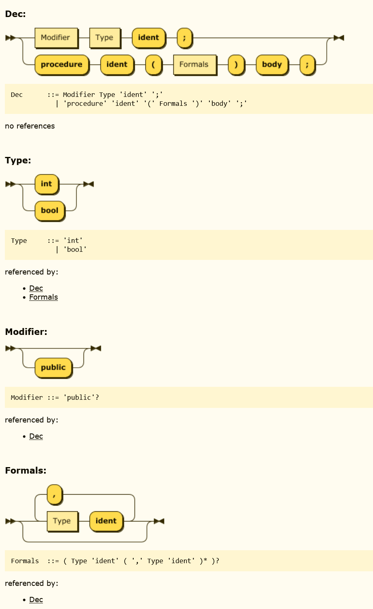
Syntax Diagram
dec ::= modifier type ident ;
dec ::= procedure ident ( formals ) body ;
type ::= int | bool
modifier ::= public | ε
formals ::= ε | type ident ( , type ident )*
https://www.bottlecaps.de/rr/ui
Notes:
Also called railroad diagram

Slide 101
Example
ident_list ::= ident
ident_list ::= ident_list , ident
Notes:
Comma separated list of at least one ident
See if this is LL(1)
FIRST(ident_list) = ident U FIRST(ident_list)
Predict (ident_list ::= ident) = {ident}
Predict (ident_list ::= ident_list , ident ) = {ident}

Slide 102
Example
ident_list ::= ident
ident_list ::= ident_list , ident
Not LL(1)
General rule: If a grammar is left-recursive, it is not LL(1)
Notes:
Comma separated list of at least one ident
FIRST(ident_list) = ident U FIRST(ident_list)
Predict (ident_list ::= ident) = {ident}
Predict (ident_list ::= ident_list , ident ) = {ident}

Slide 103
Left recursion
A grammar is left recursive if, for some nonterminal A,
A →⁺ A σ.
If there is a production of the form below, then it is left recursive
A ::= A σ | β
Left recursion may be indirect, involving several rules

Slide 104
Left recursion removal
A production of the form
A ::= A σ | β
can be replaced in the grammar with
A ::= β B
B ::= σ B | ε
B is a new symbol
Notes:
Grammars are not unique—multiple grammars can specify the same language.
The slide shows a replacement of a left recursive production with an equivalent (generates same language) that is not left-recursive.

Slide 105
Left recursion removal (2)
More generally, productions of the form
A ::= A σ1 |....|A σn| β1 | ...| βm
can be replaced by
A ::= β1 B | ....| βm B
B ::= σ1 B | .... σn B | ε

Slide 106
Example, revisited
ident_list ::= ident | ident_list , ident
Rule : replace A ::= A σ | β with
A ::= β B
B ::= σ B | ε
Let
A := ident_list
σ := , ident
β = ident
introduce new symbol ident_list_tail (instead of B )

Slide 107
Example, revisited
ident_list ::= ident | ident_list , ident
Rule : replace A ::= A σ | β with
A ::= β B
B ::= σ B | ε
Let
A := ident_list
σ := , ident
β = ident
introduce new symbol ident_list_tail instead of B
Equivalent grammar without left-recursion
ident_list ::= ident ident_list_tail
ident_list_tail ::= , ident ident_list_tail | ε

Slide 108
Transform to EBNF
A ::= β B
B ::= σ B | ε
can be replaced with
A ::= β σ*
ident_list ::= ident (, ident)*
Notes:
Equivalent language (comma separated list of at least one ident)

Slide 109
Equivalent grammars
The before-and-after grammars specify the same language
But they have different parse trees.

Slide 110
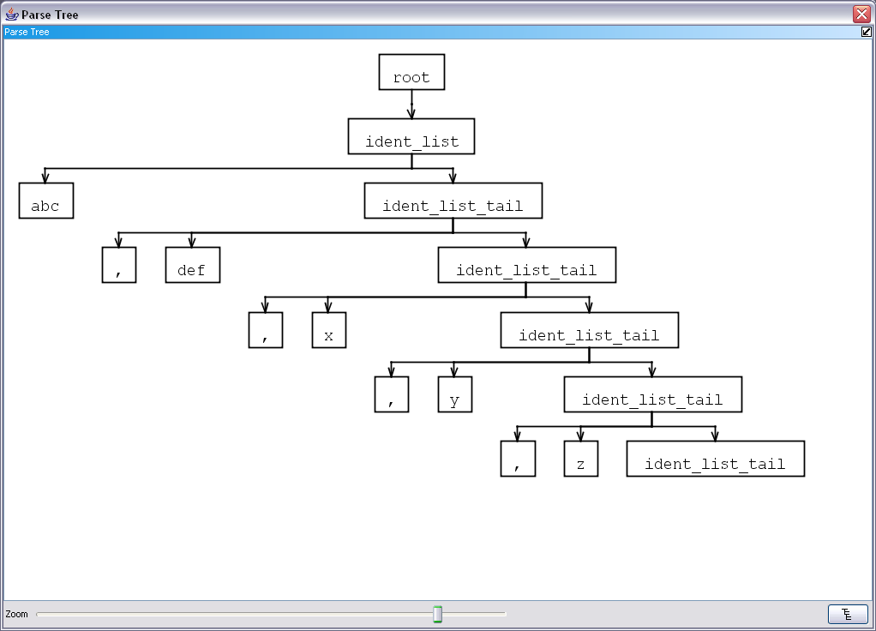
abc, def, x, y, z
ident_list ::= ident ident_list_tail
ident_list_tail ::= , ident ident_list_tail | ε
Notes:
parse tree for abc, def, x, y, z after first

Slide 111
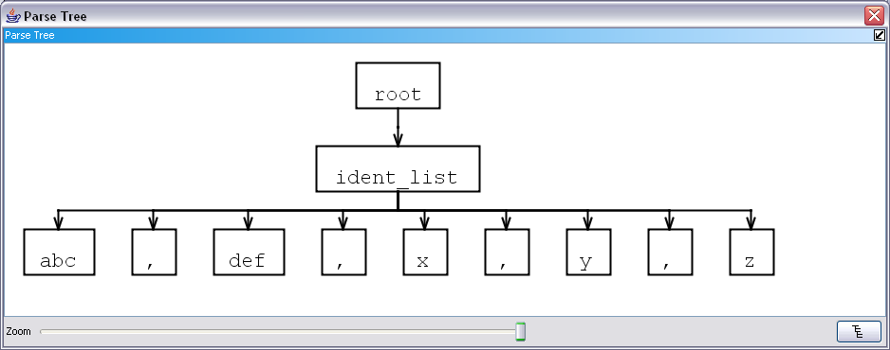
ident_list ::= ident (, ident)*

Slide 112
Recap
We like LL(1) grammars because they can be parsed with a convenient parsing algorithm (top-down, recursive descent)
Grammars with left-recursion are NOT LL(1).
We can often transform the grammar to remove left-recursion. The resulting grammar may be LL(1).
These transformations preserve the language specified by the grammar, but change the structure of the parse tree.
Often we don’t care
Expressions are an important cases where we do.
Notes:
Why do we care about the structure of the parse tree?

Slide 113
Expression evaluation
Two important conventions/properties inherited from mathematical notation
Operator precedence (order of operations)
Associativity
Also,
infix, prefix, postfix

Slide 114
Precedence
Rules that determine the order in which operations are performed when evaluating an expression.
eliminate ambiguity while allowing compact notation
following well-established mathematical conventions, * and / typically have higher precedence than + and –
Thus,
4 + 5 * 2
= 4 + (5*2)
= 14
Precedence rules can be overridden by parentheses
(4+5)*2 = 18
Notes:
2x+3

Slide 115
Associativity
Rules that apply with same operator
If an operator ⨁ in a programming language is left associative, then
x ⨁ y ⨁ z is defined to be (x ⨁ y) ⨁ z
If an operator ⨁ is right associative, then
x ⨁ y ⨁ z is defined to be x ⨁ (y ⨁ z )
Note: in mathematics, associativity is the property of an operation.
Addition is associative: (a + b) + c = a + (b + c)
Multiplication is associative (a * b) * c = a * (b * c)
etc.
Subtraction and division are not.
In programming languages, left and right associativity define the rules for evaluation.

Slide 116
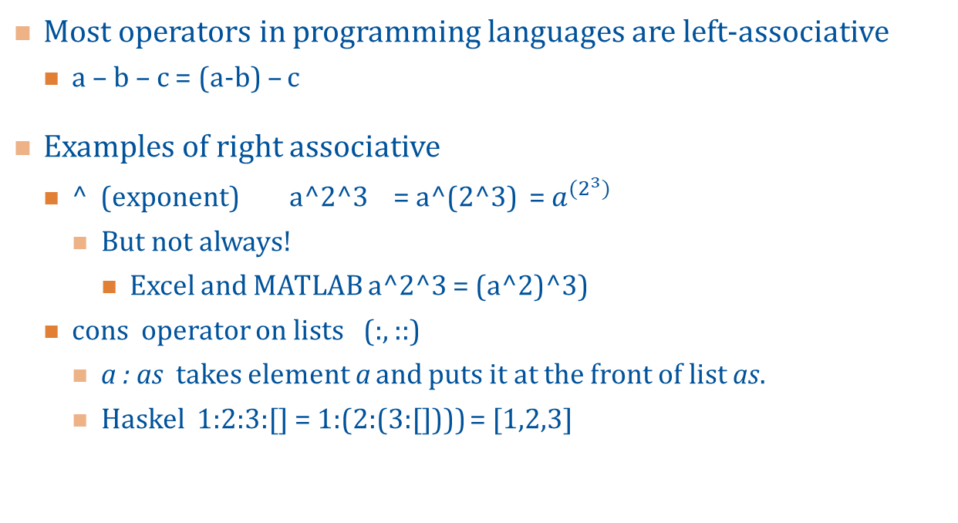
Associativity (2)
Most operators in programming languages are left-associative
a – b – c = (a-b) – c
Examples of right associative
^ (exponent) a^2^3 = a^(2^3) = $a^{{(2}^{3})}$
But not always!
Excel and MATLAB a^2^3 = (a^2)^3)
cons operator on lists (:, ::)
a : as takes element a and puts it at the front of list as.
Haskel 1:2:3:[] = 1:(2:(3:[]))) = [1,2,3]

Slide 117
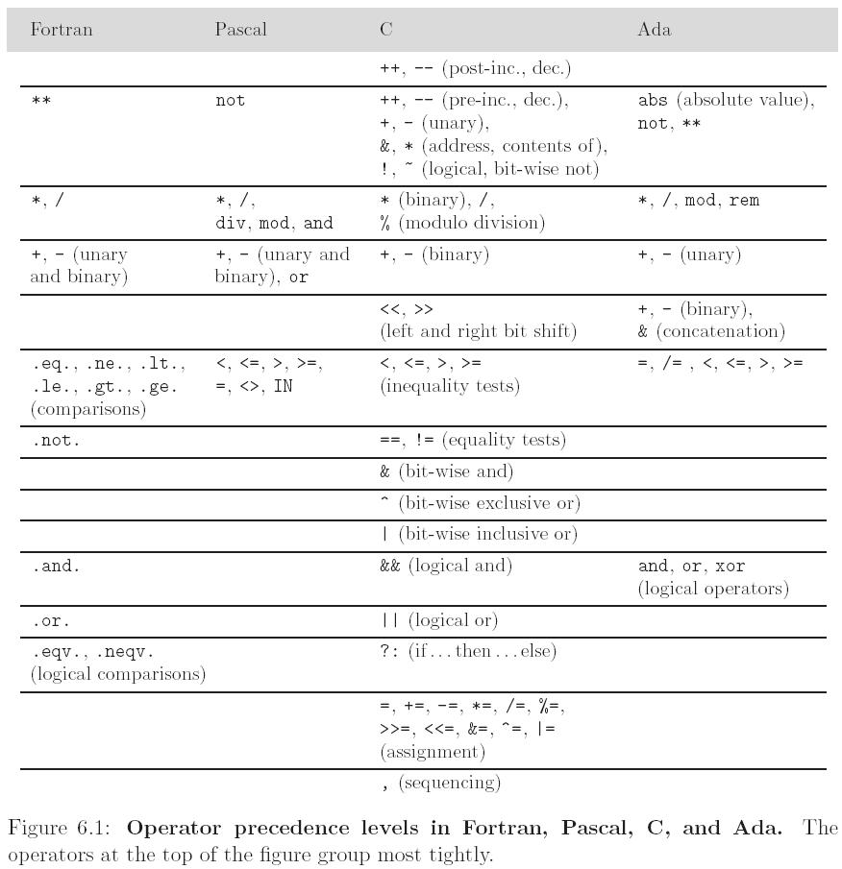
Notes:
Different programming language designers have made different choices about this.
figure: Scott. Programming Language Pragmatics, 4th ed.

Slide 118
Expression evaluation
Infix, prefix operators
Precedence, associativity
C has 15 levels - too many to remember
Pascal has 4 levels - too few for good semantics
example: A<B and C<D is interpreted as A<(B and C) < D
Fortran has 8
Ada has 6
Ada puts and and or at same level, usually and has higher precedence
Lesson: when unsure, use parentheses!

Slide 119
Goal: write grammar so that parse trees reflect desired order of evaluation
(4 + 5) * 2
4 + (5 * 2)
Notes:
Recall that parse trees (or abstract syntax trees) are a data structure that represents the program in memory.
We would like that structure to reflect the order of operations.

Slide 120
Parse trees and order of operations
4 + (5 * 2)
(4 + 5) * 2
Notes:
Recall that parse trees (or abstract syntax trees) are a data structure that represents the program in memory.
We would like that structure to reflect the order of operations.

Slide 121
Example: expression grammar with precedence and associativity
expr ::= term | expr add_op term
term ::= factor | term mult_op factor
factor ::= ident | number | - factor | (expr)
add_op ::= + | -
mult_op ::= * | /
All operators are left associative:
10-4-3 = (10-4)-3
A mult_op (*,/) has higher precedence than an add_op (+,-):
3+4*5 = 3+(4*5)
Notes:
Precedence and associatively are important aspects of expressions that are not captured by the phrase structure of the language.
However, grammars can be written so that precedence and associativity are reflected in the parse tree.
In particular, left recursion is the most useful way to indicate left associativity, but makes the grammar not LL(1).

Slide 122
Example: expression grammar with precedence and associativity
expr ::= term | expr add_op term
term ::= factor | term mult_op factor
factor ::= ident | number | - factor | (expr)
add_op ::= + | -
mult_op ::= * | /
Operators are left associative:
10-4-3 = (10-4)-3
A mult_op has higher precedence than an add_op:
3+4*5 = 3+(4*5)
Specifying Precedence
Introduce intermediate rules.
The closer to the rule containing the smallest expressions, the higher the precedence.
Notes:
Precedence and associatively are important aspects of expressions that are not captured by the phrase structure of the language.
However, grammars can be written so that precedence and associativity are reflected in the parse tree.
In particular, left recursion is the most useful way to indicate left associativity, but makes the grammar not LL(1).

Slide 123
Example: expression grammar with precedence and associativity
expr ::= term | expr add_op term
term ::= factor | term mult_op factor
factor ::= ident | number | - factor | (expr)
add_op ::= + | -
mult_op ::= * | /
Right recursion example:
Something like
term ::= factor | factor ‘^’ term
Specifying Associativity
Left associative: use left recursion
Right associative: use right recursion
Notes:
Precedence and associatively are important aspects of expressions that are not captured by the phrase structure of the language.
However, grammars can be written so that precedence and associativity are reflected in the parse tree.
In particular, left recursion is the most useful way to indicate left associativity, but makes the grammar not LL(1).

Slide 124
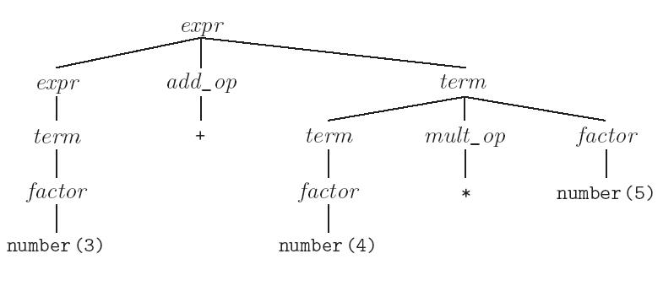
Parse tree for 3+4*5
Notes:
Can properly evaluate expression by traversing tree

Slide 125
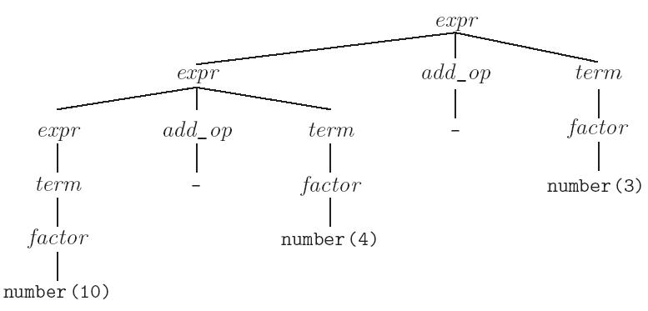
Parse tree for 10-4-3

Slide 126
Is this expression grammar LL(1)?
expr ::= term | expr add_op term
term ::= factor | term mult_op factor
factor ::= ident | number | - factor | (expr)
add_op ::= + | -
mult_op ::= * | /
Notes:
No: left recursive

Slide 127
Try removing left recursion
Start with left recursive grammar for expressions
expr ::= number | expr add_op number
add_op := + | -
Rule : replace A ::= A σ | β with
A ::= β B
B ::= σ B | ε
Notes:
A = expr
σ = addop numer
β = number
B = expr_tail
expr ::=

Slide 128
Try removing left recursion
Start with left recursive grammar for expressions
expr ::= number | expr add_op number
add_op := + | -
Rule : replace A ::= A σ | β with
A ::= β B
B ::= σ B | ε
Notes:
A = expr
σ = addop numer
β = number
B = expr_tail
expr ::= number expr_tail
expr_tail ::= add_op number expr_tail | ε
add_op ::= + | -

Slide 129
Transformed example
expr ::= number expr_tail
expr_tail ::= add_op number expr_tail | ε
add_op ::= + | -

Slide 130
Parse tree for transformed grammar
expr
3-4-5
number(3)
expr_tail
add_op
number(4)
expr_tail
Fails to correctly capture associativity
-
add_op
number(5)
expr_tail
-
ε

Slide 131
Transformed again-- to EBNF
expr ::= number | expr add_op number
add_op := + | -
expr ::= number expr_tail
expr_tail ::= add_op number expr_tail | ε
add_op ::= + | -
expr ::= number (add_op number)*
add_op ::= + | -

Slide 132
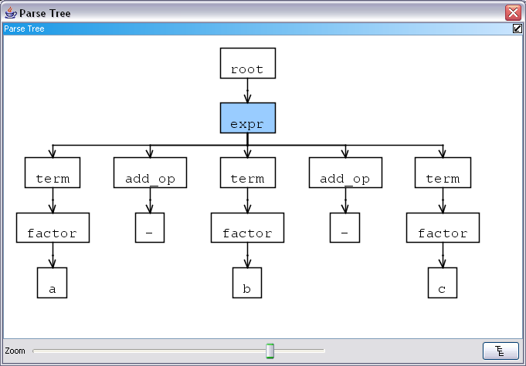
Parse tree using EBNF grammar
3-4-5

Slide 133
Parse tree using EBNF grammar
Captures associativity provided children handled from left to right
3-4-5

Slide 134
Recap
We want to write a recursive descent parser, so need an LL(1) grammar.
An LL(1) grammar cannot have left recursion
For expressions, we want the grammar to yield a parse tree that reflects order of operations.
Left associative operators are easily specified with left recursive rules
Precedence specified by introducing layers in grammar
Eliminating left-recursion changes parse tree structure – need to go to EBNF
LR grammars (which can be parsed with tool generated bottom- up parser) CAN have left recursion.

Slide 135
Another cause of non-LL(1) ness
Eliminating left recursion is NOT sufficient to get an LL(1) grammar.
Example:
A grammar with production of shape
A ::= α β | α γ
is not LL(1)

Slide 136
Transformation: Left factorization
Factor out common prefix
A ::= αβ | αγ
becomes
A ::= α B
B ::= β | γ
where B is a new non-terminal
We still need PREDICT(B ::= β ) and PREDICT( B ::= γ) to be disjoint

Slide 137
With EBNF
It is often convenient to write
A ::= α B
B ::= β | γ
as
A ::= α ( β | γ )
to avoid introducing a new symbol.

Slide 138
Example
stmt ::= ident := expr | ident ( arg_list )
arg_list ::= ….
can be transformed to
stmt ::= ident stmt_tail
stmt_tail ::= := expr | ( arg_list )
arg_list ::= ….
Or more compactly
stmt ::= ident (:= expr | ( arg_list ))
arg_list ::= ….

Slide 139
Transformations do not always work
Note that eliminating left recursion and common prefixes does NOT necessarily make a grammar LL
The few that arise in practice, however, can generally be handled with hacks

Slide 141
COP4020 Programming Language Concepts
Parsing 4
© Beverly A Sanders, 2023

Slide 142
LL(1) grammars
LL(1) grammars which admit top-down parsing with one-step lookahead.
Linear in the size of the input program
Straightforward to implemented by hand
We defined
FIRST(α) ≡ {c : α →* c β}
FOLLOW(A) ≡ {c : S →⁺ α A c β}
PREDICT(A ::= α) = FIRST(α) U (if EPS(α) then FOLLOW(A) else {}) where EPS(α) = (α →* ε)
Tells us which production to choose based on next token.
A grammar is LL(1) if the PREDICT sets of all productions with the same left-hand side are disjoint
Notes:
recall that α and β are arbitrary strings of symbols, c is a terminal. A and S are non-terminals.
FIRST(α) is the set of tokens (or ε) that appear as the first symbol in some string generated from α with 0 or more derivation steps.
FOLLOW(A) is the set of all terminal symbols that can immediately follow a subsequence derived from A in a sequence derived from the start symbol,S.
The predict set tells us which production to choose.
If we see non-terminal a, and a in PREDICT(A ::= α), then choose this production
For the choice to be unambiguous, the predict sets with same left side should be unique.

Slide 143
Left recursion removal
A grammar is left recursive if, for some nonterminal A, A →⁺ A σ.
Most obvious form: A ::= A σ | β
Left recursion may be indirect, involving several rules
A production of the form A ::= A σ | β can be replaced in the grammar with
A ::= β B
B ::= σ B | ε
where B is a new symbol, or with
A ::= β σ *
Original and transformed grammars generate same language, but parse trees have different shapes.

Slide 144
Left factorization
A ::= αβ | αγ
becomes
A ::= α B
B ::= β | γ
where B is a new non-terminal, or
A ::= α ( β | γ )
We still need PREDICT(B ::= β ) and PREDICT( B ::= γ) to be disjoint

Slide 145
Example
expr ::= @expr . field_name
| @expr . field_name = expr
| @expr . method_name ( ε | expr (, expr)* )
| … .
field_name ::= ident
method_name ::= ident
Notes:
Why are some symbols red?
Is this LL(1)? Is it left recursive?
Left factorize first two rules
expr :: = @expr.field_name (ε | = expr)
expr ::= @expr.method_name ( ε | expr (, expr)* )
Left factorize again

Slide 146
Example
expr ::= @expr . field_name (ε | = expr )
| @expr . method_name ( ε | expr (, expr)* )
| … .
field_name ::= ident
method_name ::= ident
Notes:
expr :: = @expr.field_name (ε | = expr)
expr ::= @expr.method_name ( ε | expr (, expr)* )
Left factorize again
expr ::= @expr. ( field_name (ε | = expr) | method_name ( ε | expr (, expr)* ) )

Slide 147
Example
expr ::= @expr . expr_tail
expr_tail ::= field_name (ε | = expr )
expr_tail ::= method_name ( ε | expr (, expr)* )
field_name ::= ident
method_name ::= ident
Notes:
New symbol expr_tail
Is this LL(1)?
PREDICT(expr_tail ::= field_name ….) = {ident}
PREDICT(expr_tail ::= method_anem….) = {ident}

Slide 148
Example
expr ::= @expr . expr_tail
expr_tail ::= ident (ε | = expr )
expr_tail ::= ident ( ε | expr (, expr)* )
field_name ::= ident
method_name ::= ident
Replacing nonterminals with their definition is sometimes helpful
Notes:
Now can left factorize expr_tail

Slide 149
Example
expr ::= @expr . expr_tail $
expr_tail ::= ident expr_tail_tail
expr_tail_tail ::= ε
expr_tail_tail = expr
expr_tail_tail ::= ( ε | expr (, expr)* )
Replacing nonterminals with their definition is sometimes helpful
Notes:
Need to check the predict set for the three expr_tail_tail rules.
PREDICT (expr_tail_tail ::= ε) = FOLLOW(epxr_tail) = {$}
PREDICT(expr_tail_tail = expr ) = FIRST(expr) = {@}
PREDICT(expr_tail_tail = ( ε | expr (, expr)* ) = {(}

Slide 150
Example
expr ::= @expr . expr_tail $
expr_tail ::= ident expr_tail_tail
expr_tail_tail ::= ε
expr_tail_tail = expr
expr_tail_tail ::= ( ε | expr (, expr)* )
PREDICT (expr_tail_tail ::= ε) = FOLLOW(epxr_tail) = {$}
PREDICT(expr_tail_tail = expr ) = FIRST(expr) = {@}
PREDICT(expr_tail_tail = ( ε | expr (, expr)* ) = {(}
Notes:
Need to check the predict set for the three expr_tail_tail rules.
PREDICT (expr_tail_tail ::= ε) = FOLLOW(epxr_tail) = {$}
PREDICT(expr_tail_tail = expr ) = FIRST(expr) = {@}
PREDICT(expr_tail_tail = ( ε | expr (, expr)* ) = {(}

Slide 151
Example
Now it is LL(1)!
expr ::= @expr . expr_tail $
expr_tail ::= ident expr_tail_tail
expr_tail_tail ::= ε
expr_tail_tail = expr
expr_tail_tail ::= ( ε | expr (, expr)* )
PREDICT (expr_tail_tail ::= ε) = FOLLOW(epxr_tail) = {$}
PREDICT(expr_tail_tail = expr ) = FIRST(expr) = {@}
PREDICT(expr_tail_tail = ( ε | expr (, expr)* ) = {(}
Notes:
Need to check the predict set for the three expr_tail_tail rules.
PREDICT (expr_tail_tail ::= ε) = FOLLOW(epxr_tail) = {$}
PREDICT(expr_tail_tail = expr ) = FIRST(expr) = {@}
PREDICT(expr_tail_tail = ( ε | expr (, expr)* ) = {(}

Slide 152
Example
Comment:
We need to know FOLLOW(expr).
Here it is $.
If this were a fragment of a larger grammar. FOLLOW(expr) would depend on the rest of the grammar.
expr ::= @expr . expr_tail $
expr_tail ::= ident expr_tail_tail
expr_tail_tail ::= ε
expr_tail_tail = expr
expr_tail_tail ::= ( ε | expr (, expr)* )
PREDICT (expr_tail_tail ::= ε) = FOLLOW(epxr_tail) = {$}
PREDICT(expr_tail_tail = expr ) = FIRST(expr) = {@}
PREDICT(expr_tail_tail = ( ε | expr (, expr)* ) = {(}
Notes:
Need to check the predict set for the three expr_tail_tail rules.
PREDICT (expr_tail_tail ::= ε) = FOLLOW(epxr_tail) = {$}
PREDICT(expr_tail_tail = expr ) = FIRST(expr) = {@}
PREDICT(expr_tail_tail = ( ε | expr (, expr)* ) = {(}

Slide 153
Transformations do not always work
Eliminating left recursion and using left-factorization to eliminate common prefixes is not guaranteed to make the grammar LL.
In practice, these are very useful tricks.

Slide 154
Compilation steps
Sequence of characters
Lexer
Sequence of tokens
Parser
Abstract syntax tree for correct programs
…
Notes:
Lexer recognizes tokens specified by regular expression (lexical structure), handles comments, etc.
Parser recognizes correct sentences specified by a context-free grammar and generates the data structure we use to hold the program representation in memory.

Slide 155
Systematic construction of a parser
Given an LL(1) grammar, we can systematically construct a recursive descent parser.
First version of the parser, only determine whether sentence is legal
We will ignore AST construction
The parser will determine whether a sequence of tokens is legal in the language specified by the CFG.
Revised parser
Add AST generation

Slide 156
Parser construction
Compute the PREDICT sets for each production
Rewrite the grammar so that each non-terminal is on the left side of exactly one production.
For example, change
A::= B
A::= C
to
A::= B | C

Slide 157
Parser construction (2)
For each non-terminal A, create a method
void A()
For each possible shape of the right hand side of a production
A ::= σ
we have a rule for constructing the code for the method A();

Slide 158
σ₁ | σ ₂ | ... σ_{n} (where none are ε)
if (token ∈ PREDICT(lhs ::= σ₁ )) parse σ₁ ;
else if (token ∈ PREDICT( lhs ::= σ ₂ )) parse σ ₂;
...
else if (token ∈ PREDICT( lhs ::= σ_{n} )) parse σ_{n}
else error
Notes:
lhs = left hand side

Slide 159
σ₁ | σ ₂ | ... σ_{n} | ε
if (token ∈ PREDICT(lhs ::= σ₁ )) parse σ₁ ;
else if (token ∈ PREDICT(lhs ::= σ₂ )) parse σ₂;
...
else if (token ∈ PREDICT(lhs ::= σ_{n} )) parse σ_{n} ;
else return; //this branch matches ε

Slide 160
σ₁ σ ₂ ... σ_{n}
parse σ₁;
parse σ₂;
…
parse σ_{n}

Slide 161
σ*
while(token ∈ FIRST(σ)) { parse σ; }

Slide 162
A (where A is a non-terminal)
A();
(i.e. just invoke the method for A)

Slide 163
c (where c is a token)
match(c);
where
match checks that the current token has the expected kind retrieves the next token
If not the expected token kind, throws a SyntaxException

Slide 164
c (where c is a token)
Note: the textbook uses a slightly different version of match.
match(c);
where
match checks that the current token is the expected one, and retrieves the next token

Slide 165
Implementing a Parser in Java
expr ::= term ( ( + | - ) term )*
term ::= factor ( ( * | / ) factor )*
factor ::= intlit | ( expr )
Assume you have implementations of ILexer and IToken.
Notes:
Need 3 methods: expr, term, and factor
What is start symbol? (expr)
What is predict (factor ::= intlit)?
What is predict (factor ::= ( expr ))?
Start from the inside out: implement factor first.

Slide 166
factor ::= intlit | ( expr )
Notes:
void factor () {
if (token ∈ first(intlit)){
match(INTLIT);
else if (token ∈ first ( ( expr ) ))
match( LPAREN );
expr()
match( RPAREN );
else error(“expected int literal or (“);

Slide 167
factor ::= intlit | ( expr )
void factor () {
if ( token ∈ predict(factor :: = intlit) ){ // {INTLIT}
match(INTLIT);
else if ( token ∈ predict ( ( expr ) ) ) // { LPAREN}
match( LPAREN );
expr();
match( RPAREN );
else error( “expected int literal or (“ );
Notes:
INLIT, LPAREN, RPAREN are Types of the token, identified by the Lexer.

Slide 168
term ::= factor ( ( * | / ) factor )*
Notes:
FIRST( (*|/) factor = { *, / }
void term() // term ::= factor ( ( * | / ) factor )*
{
factor();
while (isKind(t,TIMES) || isKind(t,DIV)){ consume(); factor(); }
return;
}

Slide 169
term ::= factor ( ( * | / ) factor )*
void term()
{
factor();
while (token ∈ FIRST(( * | / ) factor ) ){
if (token ∈ FIRST ( * ) match(TIMES);
else if (token ∈ FIRST ( / ) match(DIV);
else error(“expected * or /”);
factor();
}
return;
}

Slide 170
expr ::= term ( ( + | - ) term )*
void expr()
{
term();
while (token ∈ FIRST(( + | - ) term ) ){
if (token ∈ FIRST ( + ) match(PLUS);
else if (token ∈ FIRST ( - ))
match(MINUS);
else error(“expected + or -”);
term();
}
return;
}
Notes:
Same shape as term.

Slide 171
Finishing up
Implementing expressions like
token ∈ FIRST(( * | / )
Suggestion
IToken t; //always holds current token
protected boolean isKind(Kind kind) {
return t.getKind() == kind;
}
protected boolean isKind(Kind... kinds) {
for (Kind k : kinds) {
if (k == t.getKind())
return true;
}
return false;
}
Notes:
pet peeve: if (t.getKind()==kind) return true; else return false; DON’T DO THIS.
Second version uses Java variable number of parameters
Later we will talk about names and binding more systematically. Here is an example of overloading: we have two different methods with the same name. Compiler distinguishes by type of argument. Compiler also converts parameter list into List. Can be accessed like any list or here we use the for syntax.

Slide 172
public void expr() // expr ::= term ( ( + | - ) term )*
{
term();
while (isKind(PLUS, MINUS) ) { consume(); term(); }
return;
}
void term() // term ::= factor ( ( * | / ) factor )*
{
factor();
while (isKind(TIMES,DIV)){ consume(); factor(); }
return;
}
void factor() //factor ::= int_lit | ( expr )
{
if (isKind(INT_LIT)) { consume();}
else if (isKind(LPAREN)) {
consume();
expr();
match(RPAREN);
}
else error();
return;
}
Notes:
Can use consume when you are sure that match will succeed. It reads the next token.

Slide 174
COP4020 Programming Language Concepts
Abstract Syntax Trees
© Beverly A Sanders, 2023

Slide 175

A moment of silence for Erik Rushford
Moment of silence for Erik Rushford
Notes:
I am so very sorry to share that your student Erik Rushford, a fifth-year senior majoring in computer science, passed away over the weekend.
It is always difficult to lose one of our students. You will likely be one of the individuals to whom students look for information. Here is a suggestion for what you might say at your next class meeting:
“I am very sorry to share that your classmate Erik Rushford has passed away. All of us are saddened by this loss. There are many resources on campus to assist you should you need it. You may stop by my office hours or speak with me after class. Also, a 24/7 counselor is available to speak by phone at 352-392-1575. You can also make an appointment for the Counseling Center at that number. The U Matter We Care Program can assist you or a friend in distress. You can reach them via their website or call (352) 392-1261. Additionally, the Alachua County Crisis Center provides free 24/7 crisis and suicide prevention support and can be contacted at (352) 264-6789. Reach out and let me know if you need additional assistance.”
If you feel uncomfortable having that conversation in class, I can request for a counselor to come do that conversation with you. Also, you as a faculty member can make use of 24/7 counseling support through the Employee Assistance Program, Call: 833.306.0103 or TTY: 800.697.0353.
If one of your students gets particularly upset during class, you may choose to walk with or request the assistance of another student to send that student to 401 Peabody Hall to meet with a crisis counselor at the Counseling and Wellness during business hours (9 am – 4 p.m.).
Please do not hesitate to contact me if I can be of help through this difficult time.
Sincerely,

Slide 176
Campus Resources
You may stop by my office hours (3pm Mondays) or speak with me after class. If the time of my office hours doesn’t work for you, please contact me to arrange another time.
A 24/7 counselor is available to speak by phone at 352-392-1575.
You can also make an appointment for the Counseling Center at that number.
The U Matter We Care Program can assist you or a friend in distress. You can reach them via their website (umatter.ufl.edu/refer-or-report) or call (352) 392-1261.
The Alachua County Crisis Center provides free 24/7 crisis and suicide prevention support and can be contacted at (352) 264-6789.

Slide 177
So far: Concrete Syntax
Specified with context-free grammar
Specifies syntactically valid programs
Used to construct parser for programming languages
It is important that the concrete syntax belong to a class that admits efficient parsing.
For example, is LL(1)
Parse trees represent structure of sentences
Include all tokens, including ones that are not interesting once parsing is complete.
Examples: semicolons, parentheses, etc.

Slide 178
Abstract Syntax
Specified with context-free grammar
Specifies important structures
Only constructed for syntactically correct programs (according to concrete syntax)
We do not parse sentences in abstract syntax
Not concerned about LL-ness
Represented by Abstract Syntax Tree
An AST the data structure that will use to store a program in memory for additional processing.

Slide 179
Comparison of concrete and abstract syntax
Concrete syntax for if statements in two languages
C-family language:
if_statement ::= if ( expr ) block
block ::= { (statement ;)* }
Algol-family language
if_statement ::= if expr then block
block ::= begin
(ε | statement (; statement)*) end
Abstract syntax for both
if_statement ::= if expr block
or possibly
if statement ::= expr block
Notes:
Could even have abstract if_statement ::= expr block

Slide 180
Example: Expressions
Concrete syntax for expressions
expr ::= term ( ( + | - ) term )*
term ::= factor ( ( * | / ) factor )*
factor ::= int_lit | ( expr )
Abstract syntax
expr ::= int_lit | expr (+|-|*|/) expr
Notes:
Concrete syntax was complicated because we need to express associativity and operator precedence.

Slide 181
Abstract vs. Concrete Syntax for Expressions
Concrete syntax for expressions is complicated in order to handle precedence and associativity of operators and overriding with parentheses.
Abstract syntax no longer specifies the precedence of the operators BUT we will construct an abstract syntax tree during parsing the concrete syntax so that the constructed tree has the correct structure.
We do not parse abstract syntax
Thus, we do not care whether abstract syntax is LL(1) or not.

Slide 182
OO implementation of an abstract syntax tree
All nodes in AST are subclasses of a common abstract base class
The basic idea is
Define a class for each non-terminal in the abstract syntax
If there are multiple productions for a non-terminal, make the non-terminal class abstract, and introduce a subclass for each production

Slide 183
AST for Expressions
abstract class ASTNode
superclass of all nodes in AST
anticipating that later we will have more than expressions in our language
abstract class Expr extends ASTNode
superclass of all nodes that represent expressions
class IntLitExpr extends Expr
class that represents expressions that are int literals
class BinaryExpr extends Expr
class that represents binary expressions

Slide 184
ASTNode
abstract class ASTNode {
public final IToken firstToken;
public ASTNode(IToken firstToken){
this.firstToken = firstToken;
}
…
}
Notes:
What is the point of firstToken?

Slide 185
ASTNode
Why do we need firstToken?
firstToken preserves info about the location in the source code of the construct
firstToken will be inherited by BinaryExpr and IntLitExpr
firstToken should refer to the first token in the construct
get position of (start of) construct from position of firstToken
abstract class ASTNode {
public final IToken firstToken;
public ASTNode(IToken firstToken){
this.firstToken = firstToken;
}
…
}
Notes:
What is the point of firstToken?

Slide 186
AST for Expressions
expr ::= int_lit
expr ::= expr (+|-|*|/) expr
Class for Expr nodes
abstract class Expr extends ASTNode{…}
class IntLitExpr extends Expr {…}
class BinaryExpr extends Expr {…}
Note: this is an example which illustrate how to approach the project, but you will need to adapt the details

Slide 187
Expr
abstract class Expr extends ASTNode{
public Expr(IToken firstToken){
super(firstToken);
}
…
}

Slide 188
IntLitExpr
expr ::= int_lit
Only one token, so firstToken sufficient
class IntLitExpr extends Expr
{
public IntLitExpr(IToken firstToken){
super(firstToken);
}
public int getValue() {
return firstToken.getIntValue();
}
…
}
Notes:
IntLitExpr only has one Token, which is already being saved as firstToken.

Slide 189
BinaryExpr
class BinaryExpr extends Expr
{
public final Expr left;
public final IToken op;
public final Expr right;
public BinaryExpr(IToken firstToken, Expr left, IToken op, Expr right){
super(firstToken);
this.left = left;
this.op = op;
this.right = right;
}
…
}
expr ::= expr (+|-|*|/) expr
We need to represent two expression and an operator
Notes:
Children have type Expr—so they can be either IntLitExpr or BinaryExpr

Slide 190
AST for Expressions
3 * (4 + 5)
expr ::= int_lit
expr ::= expr (+|-|*|/) expr
Class for Expr nodes
abstract class Expr extends ASTNode{…}
class IntLitExpr extends Expr {…}
class BinaryExpr extends Expr {…}
*
3
+
4
5
Notes:
blue: BinaryExpr
orange: IntLitExpr
red: IToken

Slide 191
Modify parser to generate AST
Each method of the parser returns the AST for the construct it represents
In this example, the parser has 3 methods: expr, term, and factor
expr ::= term ( ( + | - ) term )*
term ::= factor ( ( * | / ) factor )*
factor ::= int_lit | ( expr )

Slide 192
modifications to factor method
from concrete syntax
factor ::= int_lit | ( expr )
if the factor is an int_lit, the factor method should return an IntLitExpr node
if the factor is a parenthesized expression, the factor method should return an Expr node corresponding to the expression

Slide 193
Modifications to factor
//factor ::= int_lit | ( expr )
Expr factor() {
IToken firstToken = t; Expr e = null;
if (isKind(INT_LIT)) { e = new IntLitExpr(firstToken);
consume(); } else if (isKind(LPAREN)) { consume(); e = expr(); match(RPAREN);
} else error(); return e;
}
Save current token, t
Create an IntLitExpr object
Get the AST corresponding the expr
Notes:
Recall that t is always the current token.

Slide 194
Modifications to expr and term
expr ::= term ( ( + | - ) term )*
term ::= factor ( ( * | / ) factor )*
Returns AST for single term or factor,
or BinaryExpr

Slide 195
Modification to expr (term is similar)
//expr ::= term (( + | - ) term )*
public Expr expr(){
IToken firstToken = t;
Expr left = null;
Expr right = null;
left = term();
while (isKind(PLUS) || isKind(MINUS))
{ IToken op = t;
consume();
right = term();
left = new BinaryExpr(firstToken, left, op, right);
}
return left;
}

Slide 196
Example
3 * (4 + 5)
expr ::= term ( ( + | - ) term )*
term ::= factor ( ( * | / ) factor )*
factor ::= int_lit | ( expr )
TODO:
work through code and convince
yourself that this
AST will be created.
*
3
+
4
5
Notes:
blue: BinaryExpr
orange: IntLitExpr

Slide 197
Action routines
expr ::= Expr left =term
(op= ( + | - ) right=term
left = new BinaryExpr(left,op,right) )*
return left;
term ::= Expr left =factor
(op= ( * | / ) right=factor
left = new BinaryExpr(left,op,right) )*
return left;
factor ::= return new IntLitExpr( int_lit )
| ( return expr )
Embed actions (or code snippets) into grammar
Action performed when parser gets to that point (code snippet inserted into parser)

Slide 198
What do we do with an AST?
The AST represents the program in memory
We traverse the AST for multiple purposes
Interpretation
Compilation phases
type checking
code generation

Slide 199
Design problem
Setting
We have a data structure, the AST, with several different types of nodes.
We want to traverse the data structure multiple times with different effects
type checking
code generation
While traversing the structure, the action depends on the type of the node
IntLitExpr
BinaryExpr

Slide 200
Possible solution: add method to superclass for each purpose
Proposed solution 1
add a method to the superclass
one for type checking, one for code generation
override method in subclasses
call the corresponding method at each node.
Disadvantages:
Mixes up code for data structure itself with code for traversal and effects.
Needs several methods, adding a new function requires changing all the AST node classes

Slide 201
Possible solution: Add a method to superclass that makes decisions based on type
Add a method to the superclass that makes decisions based on type
if (this instanceof InLitExpr){…}
else if (this instanceof BinaryExpression {…}
Disadvantages:
Still putting function code in data structure
Superclass needs to know about all the subclasses

Slide 202
Better: Visitor Pattern
“Represent an operation to be performed on the elements of an object structure. Visitor lets you define a new operation without changing the classes of the elements on which it operates”*
Requires some infrastructure in AST classes
Action taken at a node depends on the type of the node and the type of the Visitor (double dispatch)
Create a Visitor for Type checking, another Visitor for code generation
Compiler generator tools often incorporate support for the visitor pattern
*from GOF book

Slide 203
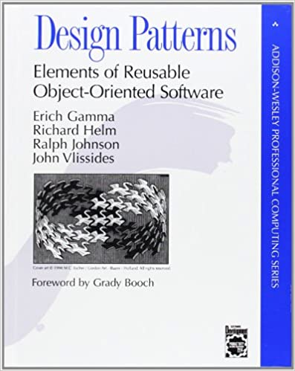
Design pattern
Solution to problem in a context
Kent Beck originated ideas of design pattern inspired by work of architect Christopher Alexander
“Gang of Four” (GOF) wrote the book that popularized the idea (for C++) 1994.

Slide 204
How to instrument a data structure to allow the Visitor pattern
Define a Visitor interface
include a visitX method for each type X of node in the data structure.
For node type X the method in the interface has signature
public Object visitX(X node, Object arg);
The visitX methods typically involve calling the visit method of it’s children.
The returned Object passes info from child to parent
The Object arg parameter passes info from parent to child
Returned value and arg can be null if nothing to pass.

Slide 205
Visitor interface for Example
public interface ASTVisitor
{
public Object visitIntLitExpr(IntLitExpr e, Object arg);
public Object visitBinaryExpr(BinaryExpr e, Object arg);
}

Slide 206
Visit method
Superclass: add abstract visit method
abstract class ASTNode
{
…
public abstract Object visit(ASTVisitor v, Object arg);
}
Concrete classes implementing the nodes must provide an implementation of their visit method.
In subclasses:
In class X,
public Object visit(ASTVisitor v, Object arg) { return v.visitX(this, arg); }
In some descriptions of the visitor pattern, this method is called accept instead of visit.

Slide 207
Expr
abstract class Expr {
public final IToken firstToken;
public Expr(IToken firstToken){
this.firstToken = firstToken;
}
public abstract Object visit(ASTVisitor v, Object arg);
}

Slide 208
IntLitExpr
class IntLitExpr extends Expr
{
public IntLitExpr(IToken firstToken){
super(firstToken);
}
public int getValue() {
return firstToken.getIntValue();
}
@Override
public Object visit(ASTVisitor v, Object arg) {
return v.visitIntLitExpr(this, arg);
}
}
Notes:
IntLitExpr only has one Token, which is already being saved as firsToken.

Slide 209
BinaryExpr
// expr ::= expr (+|-|*|/) expr
class BinaryExpr extends Expr
{
public final Expr left;
public final IToken op;
public final Expr right;
public BinaryExpr(IToken firstToken, Expr left, IToken op, Expr right){
super(firstToken);
this.left = left;
this.op = op;
this.right = right;
}
@Override
public Object visit(ASTVisitor v, Object arg) {
return v.visitBinaryExpr(this, arg);
}
}
Notes:
Children have type Expr—so they can be either IntLitExpr or BinaryExpr

Slide 210
Example: Visitor pattern to evaluate expressions
Idea: Each visit method returns the value of the expression represented by its AST node.

Slide 211
Implement Visitor Interface
public class ExprEvalVisitor implements ASTVisitor
{
public Object visitIntLitExpr
(IntLitExpr e, Object arg){ … }
public Object visitBinaryExpr
(BinaryExpr e, Object arg){ … }
}

Slide 212
Implement Visitor Interface (2)
public class ExprEvalVisitor implements ASTVisitor
{
public Object visitIntLitExpr
(IntLitExpr e, Object arg){ return e.getVal();}
//continued on next slide

Slide 213
Implement Visitor Interface(3)
public Object visitBinaryExpr(BinaryExpr e, Object arg){
int left = (Integer) e.left.visit(this, arg);
int right = (Integer ) e.right.visit(this,arg);
Kind opKind = e.op.getKind();
int val = switch(opKind){
case PLUS -> left + right;
case MINUS -> left – right;
case TIMES -> left * right;
case DIV -> left/right;
default -> {…}
}
return val;
}

Slide 214
To read and compute the value of an expression
//Create a parser instance (the parser creates a lexer)
IParser parser = new CompilerComponentFactory.getParser(input);
//Call the Parser’s expr method to get an AST
Expr ast = parser.expr();
//Create an instance of a visitor
ExprEvalVisitor v = new ExprEvalVisitor();
//call the visit method of the ast
int value = (Integer) ast.visit(v, null);
Notes:
Expressions can be evaluated with a simpler program, but this is a good example of the visitor pattern.
The arg parameter allows information to be passed from parent to child as the AST is traversed. In this example, the info was all from child to parent, so we didn’t need the arg parameter.

Slide 215
Aside on Java: Autoboxing
Motivation: int value = (Integer) ast.visit(v, null);
Objects vs primitive types
Objects are explicitly allocated on heap with new
SomeObject oref = new SomeObject(…);
Primitive types are implicitly allocated on stack (or in static memory)
int x;

Slide 216
Wrapper classes
Classes like java.lang.Integer, java.lang.Float, etc. “wrap” a value of primitive type so it can be used where an Object is expected.
Example: https://cr.openjdk.java.net/~iris/se/19/latestSpec/api/java.base/java/lang/Integer.html
public final class Integer extends Number implements Comparable<Integer>, Constable, ConstantDesc
The Integer class wraps a value of the primitive type int in an object. An object of type Integer contains a single field whose type is int. .
In addition, this class provides several methods for converting an int to a String and a String to an int, as well as other constants and methods useful when dealing with an int.
…

Slide 217
Conversion between object and primitive type
Early versions of Java required the programmer to explicitly convert.
If an object is expected, but you have an int, say int x:
Integer Y = Integer.valueOf(x)
If an int is expected, but you have an Integer, say Y
int x = Y.intValue();

Slide 218
Autoboxing
Automatic conversion between primitive types and wrappers
Can write
Integer Y = x; //x is an int
int x = Y; //Y is an Integer
Similarly for parameters and return values
Conversions on previous slide with calls to valueOf/intValue are still being performed
The compiler inserts the necessary calls, so the programmer does not need to do it.

Slide 219
Example
int value = (Integer) ast.visit(v, null);
visit was declared to return Object, must explicitly cast to Integer
The Integer is autoboxed to int.

